Slide 1

Library Leader Lessons Learned: Speed Up Your Career
E304
Stephen Abram, MLS
Lighthouse Consulting, Inc.
March 19, 2026

Slide 2
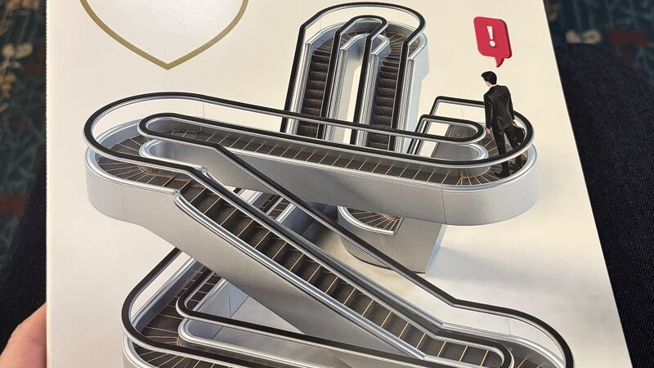

Slide 3
There are lots of challenges and threats facing us as Information Professionals in 2026: Short List
Existential Threats from Administrations that are:
  Anti-inclusion and DEI, Anti-women, Anti-BIPOC, anti-Indigenous, …
  Anti-professions like academics, teaching, librarianship, etc. though criminalizing our work
  Anti-Research and Information Access and sharing (Content Disappearances like ERIC, CIA Factbook, Digital Archives, and too many more to accurately predict, harvest and protect)
  Taxonomy and Ontology threats and actions
Existential Threats to our Institutions including:
  IMLS, ALA, NIH, Military Libraries, library boards, etc.
  Academia and Academic Freedom
  Curriculum Changes
  Research Enterprises
Threats to our Shared Values
  Democracy
  Freedom to Read
  Balance in Copyright
  Anti-Book bans and Censorship
  Diversity, Migration, Labour mobility
  Education
  Critical Thinking versus Doctrine Education
  Privacy (Palantir, OpenAI/Anthropic and Military guardrails)
  Freedom of Faith and Religion
  Freedom of Expression

Slide 4

Some Associations Have Stepped Up Well
ALA
PEN
EveryLibrary (note CC sharing)
MLA
AALL
Brewster Kahle and Internet Archive (and the other protectors / harvesters
Some have not:
SLA in the 5 years before dissolving and merging with
ASIS&T
Library Association Federal Government Relations Positions in Difficult Times: SLA, ASIST, ALA, AALL, MLA, EveryLibrary . . .
https://stephenslighthouse.com/?p=62218

Slide 5
So, how do we thrive in this environment?
Summary
Office and Professional Politics
Balance in Life is not an everyday thing
Wine, Whine, and Wisdom
Critical Thinking and Cognitive Bias as core to Information Fluency
Traditions as Boat Anchors
Re-Imaginization

Slide 6

Politics is a game, not really . . .
Games are fun to play and teach strategies
Politics has real consequences and is ongoing – sort of like playing Monopoly through to the end . . .

Slide 7
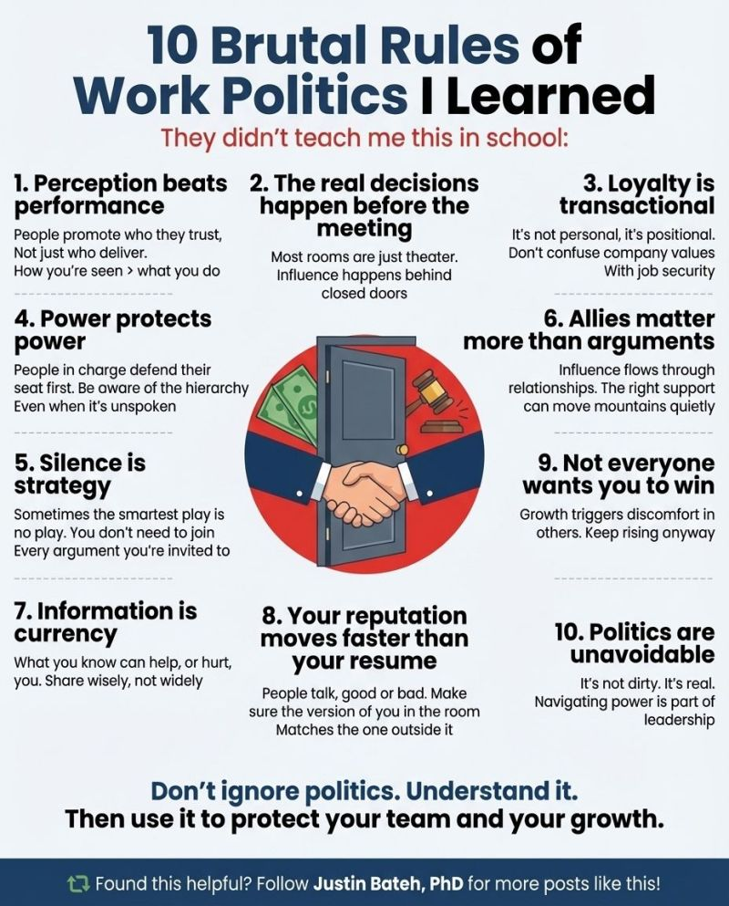

Slide 8

Balance

Slide 9
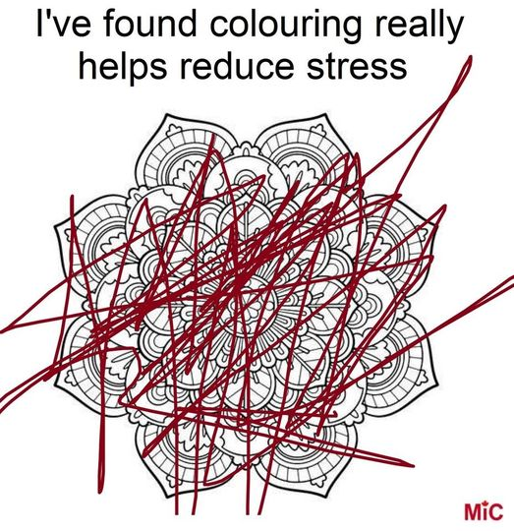
Success Doesn’t Come from Colouring in the Lines

Slide 10

Think Bigger
Be concerned about inclusivity on a daily basis or change the Constitution?
Be concerned about education funding and curriculum, or think bigger and influence funding by $198 billion?
Be concerned about Indigenous Reserves or engage in political processes as an ally
See women and other protected groups rights being trampled . . .
See the digital juggernaut before it flourishes?
See the need for greater collaboration in libraries?

Slide 11
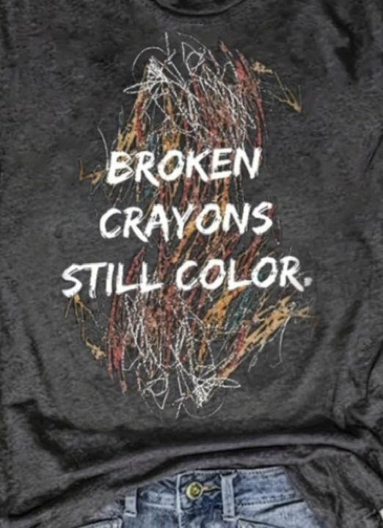
Your Trauma(s) Are Your Strength

Slide 12
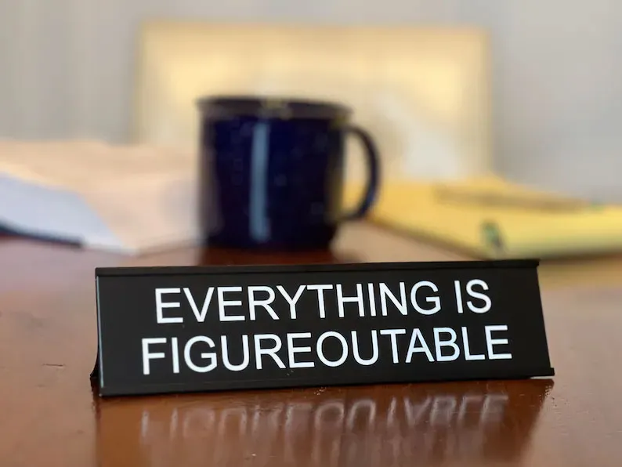
FAFO

Slide 13
PTSD versus PTSI
Help me understand post traumatic stress injuries versus PTSD
https://stephenslighthouse.com/?p=68374

Slide 14

Take Every Self-Understanding Test You Can
Reflection is a strength
Daily Random Astrology Reflection
MBTI
DISC
Colours
CBT
Advanced executive testing
IQ, EQ, SQ, . . .
ADD, ADHD, and other spectrums

Slide 15


Slide 16
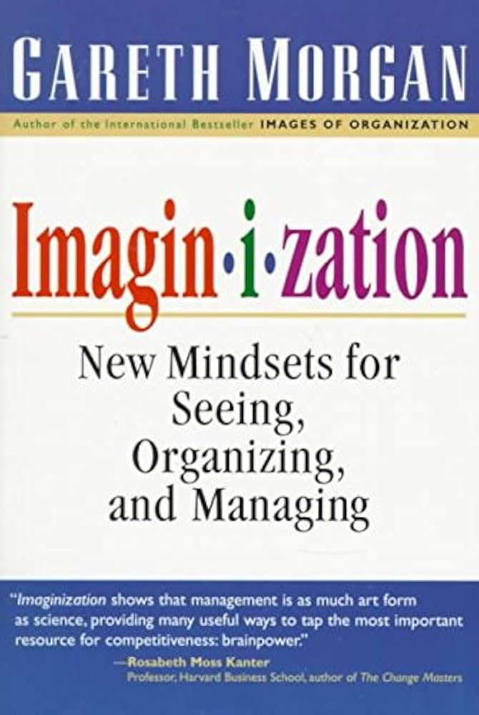
Re-Imaginization

Slide 17
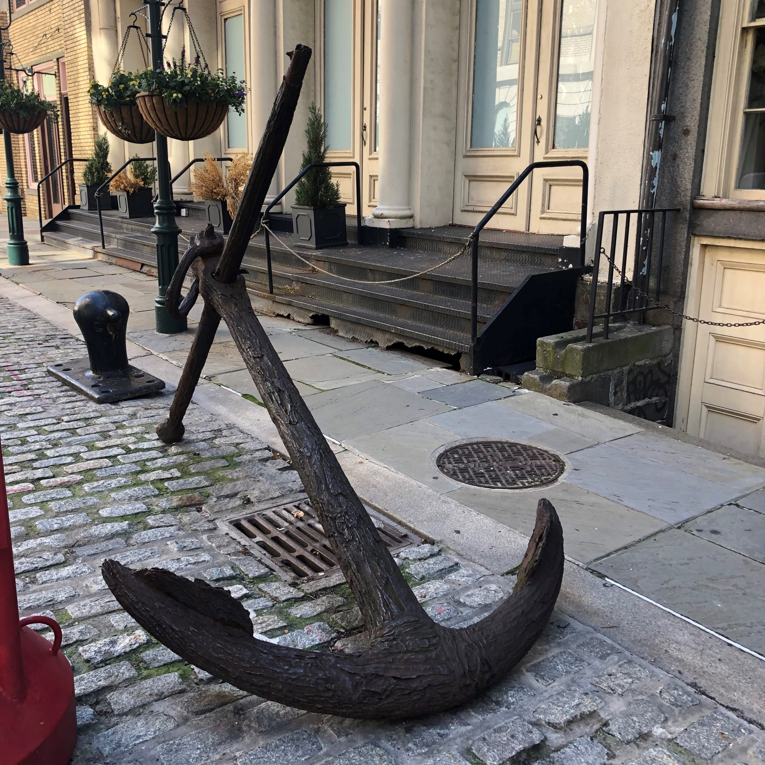
Traditions as Boat Anchors
What do you do on a ship in a Tsunami?
Anchors
Aweigh!

Slide 18
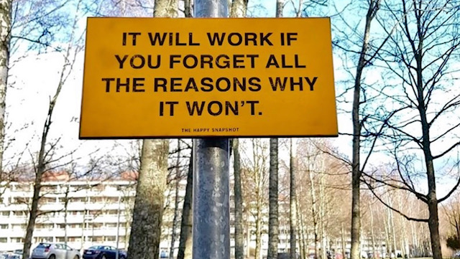

Slide 19

Don’t tamp down
Being Triggered
Being Frustrated
Being Angered
Emotions are clues and symptoms of your soul telling you to do something.

Slide 20
My Five Lessons
Understand YOU: Lean into yourself, your passions, your faults and your strengths
Whine with intent . . . With your tribe of likeminded folks
Think Bigger and bring folks along the way, followership is a skill
Reimagine the future and create the path step-by-step
Play politics, play with the new stuff, play with your tribe, learn for life
If you don’t the future will happen to you instead of with you.

